Slide 1
Title of Paper
HOTPOTQA: A Dataset for Diverse, Explainable Multi-hop Question Answering
（HOTPOTQA：多样化、可解释的多跳问题回答数据集 EMNLP 2018）
汇报人：周星辰

Slide 2
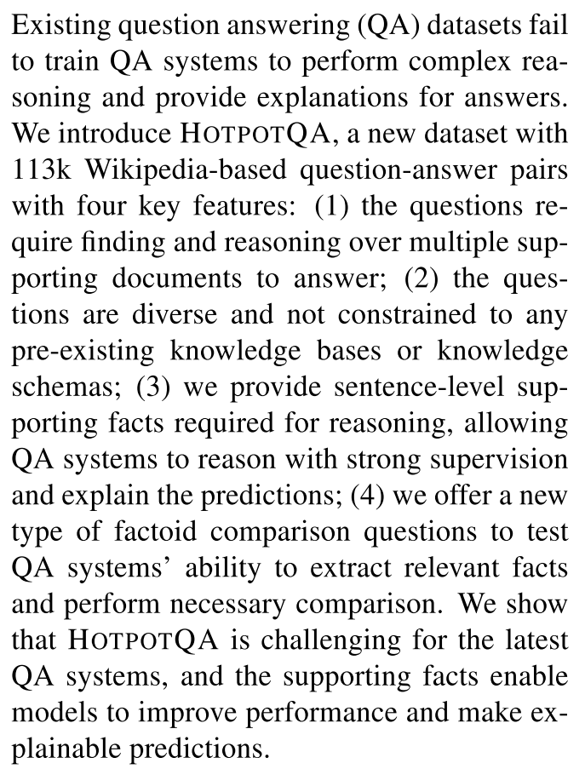
0. Abstract
The authors introduce HOTPOTQA, which is challenging for latest QA systems.

Slide 3
1. Introduction
The ability to perform reasoning and inference over natural language is an important aspect of intelligence.
However, existing datasets have limitations that hinder further advancements of machine reasoning over natural language.
Datasets only provide distant supervision, like the systems only know what the answer is, but do not know what supporting facts lead to it.
Example: All datasets mentioned above
Existing datasets that target multi-hop reasoning are constructed using existing knowledge bases(KBS). Constrained by the schema of KBS, the diversity of questions and answers is inherently limited.
Example: Qangaroo、COMPLEXWEBQUESTIONS
Some datasets mainly focus on testing the ability of reasoning within a single paragraph or document, or single-hop reasoning.
Example: SQuAD、TriviaQA、SearchQA

Slide 4
1. Introduction
Aim: Create a dataset that contains these three features
Requires reasoning over multiple documents.
Use natural language, without constraining to existing KB.
Provide systems with strong supervision about what text the answer is actually derived from, to help guide systems to perform meaningful and explainable reasoning.

Slide 5
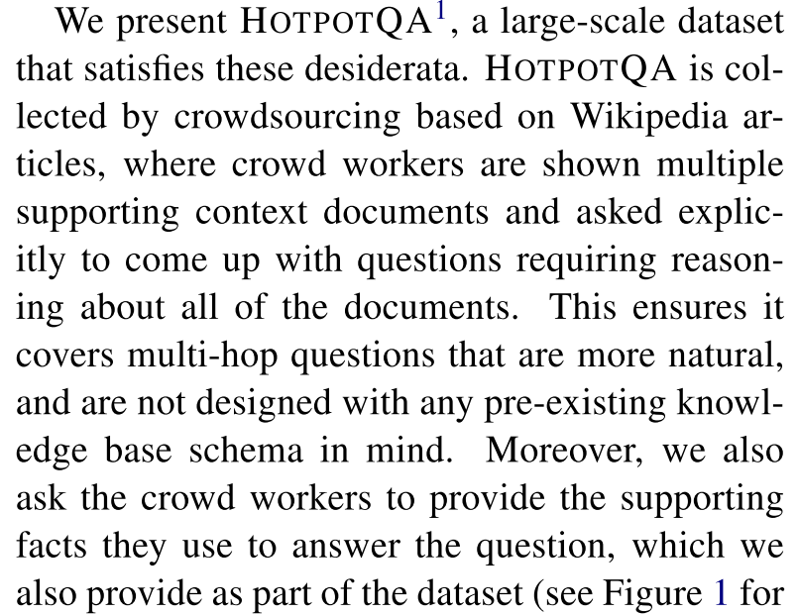
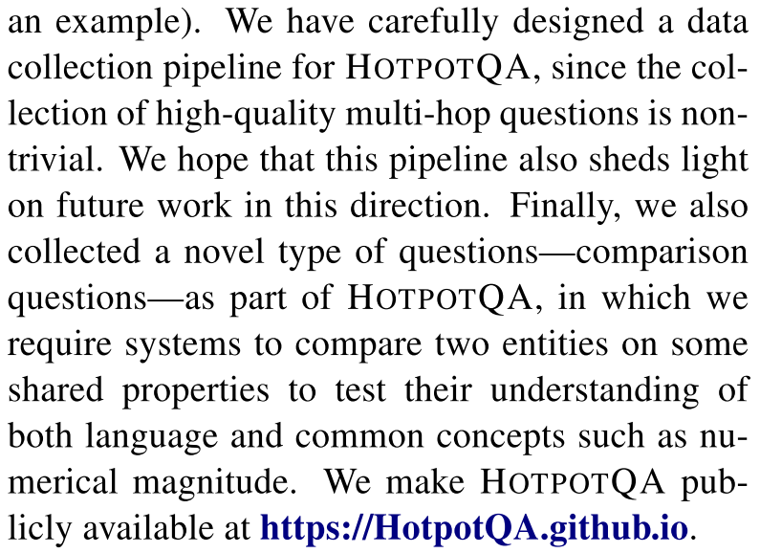
1. Introduction
Introduction of the work:

Slide 6
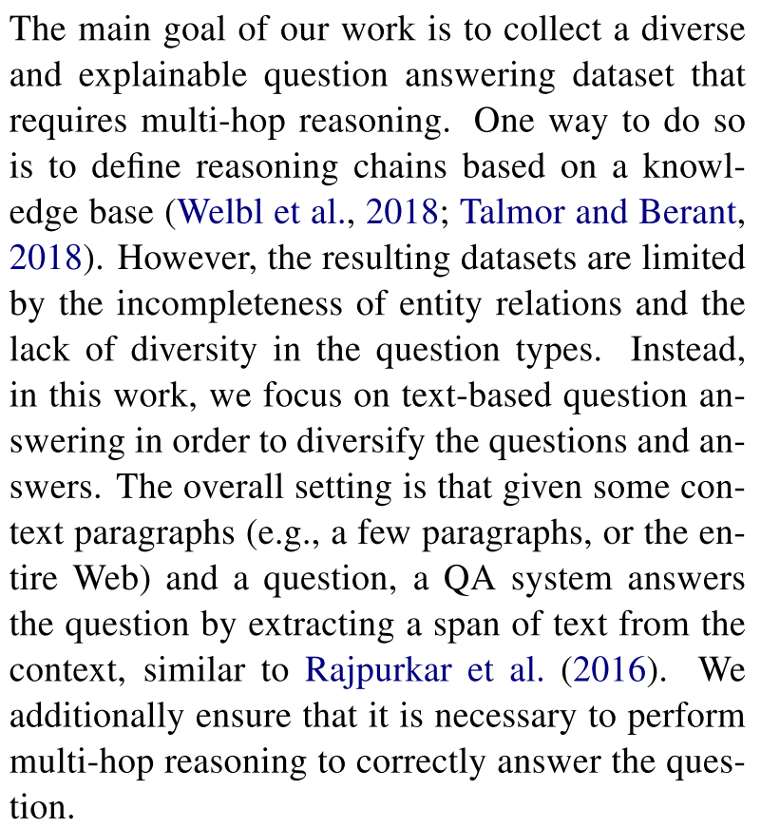
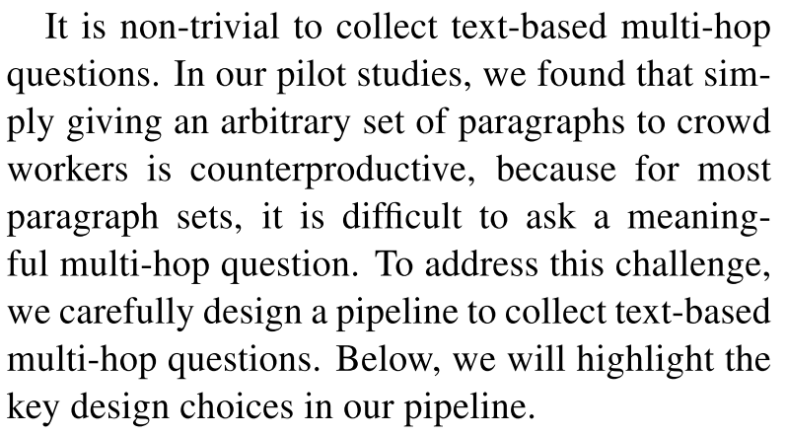
2. Data Collection

Slide 7
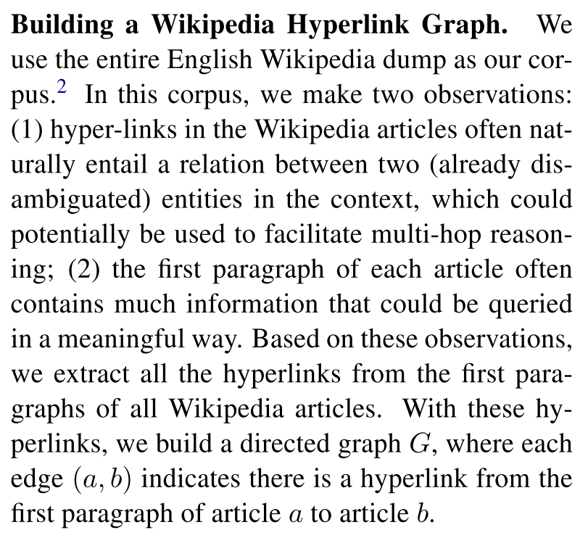
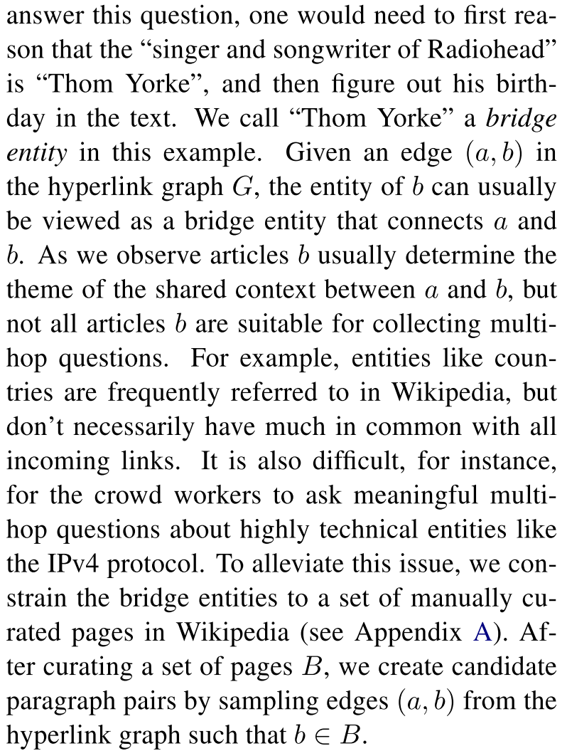
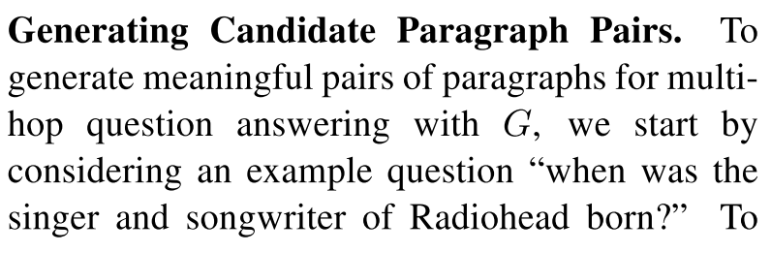
2. Data Collection

Slide 8
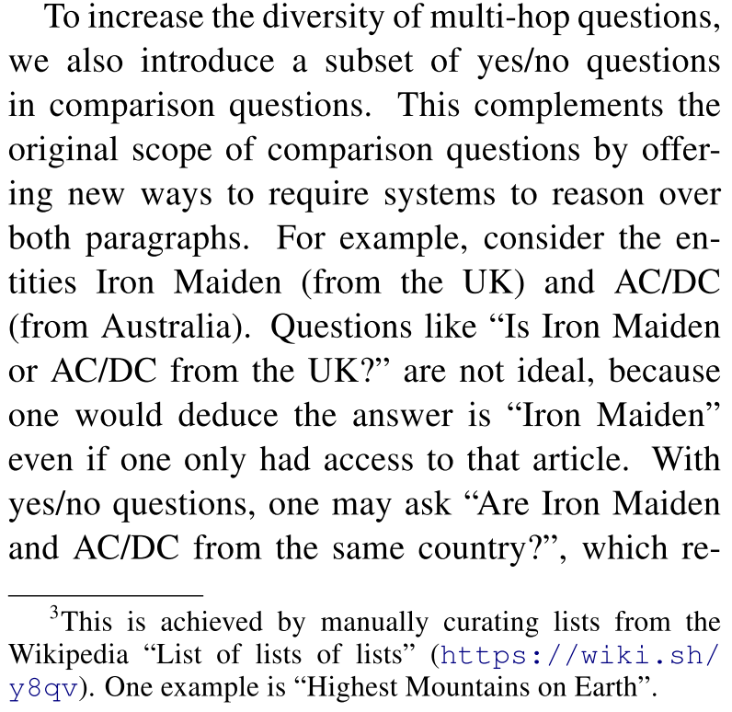
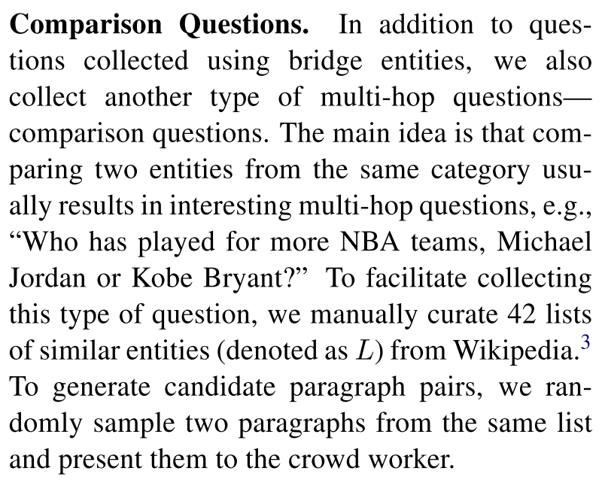
2. Data Collection

Slide 9
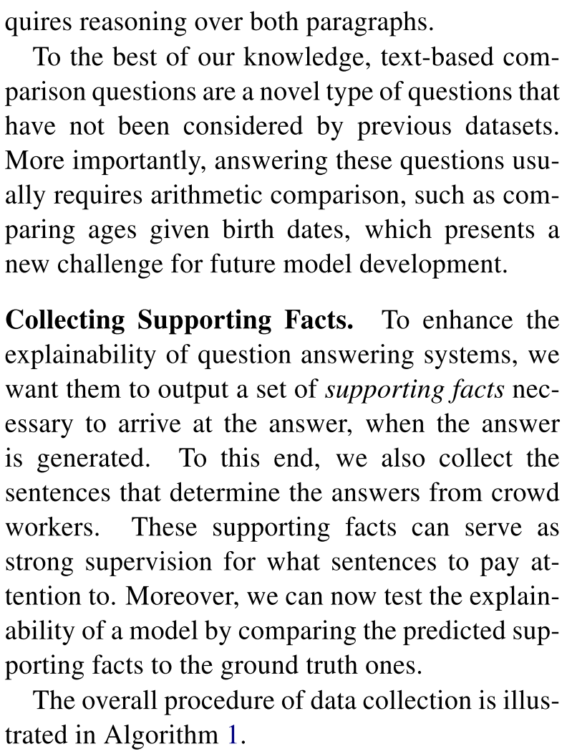
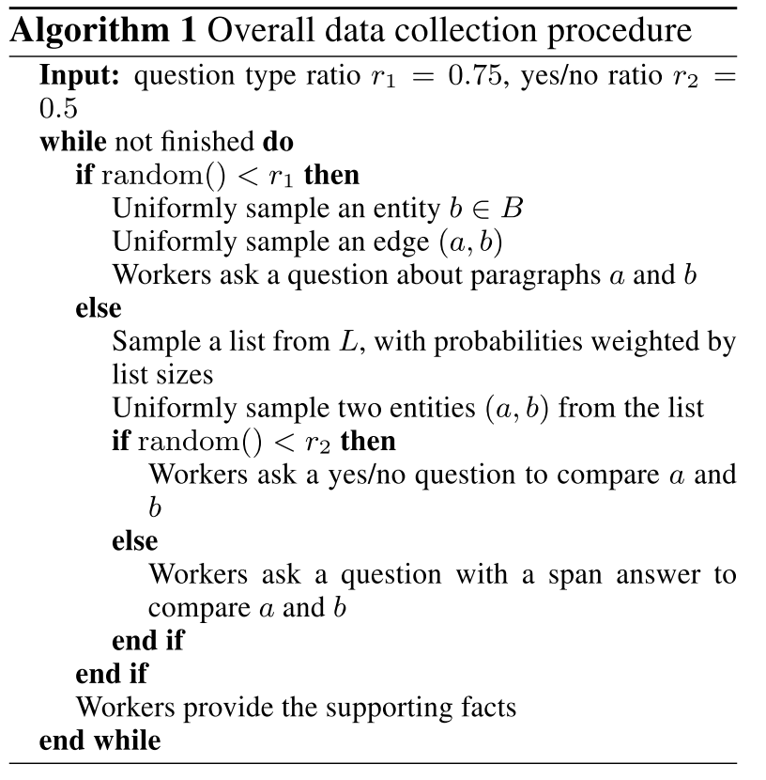
2. Data Collection

Slide 10
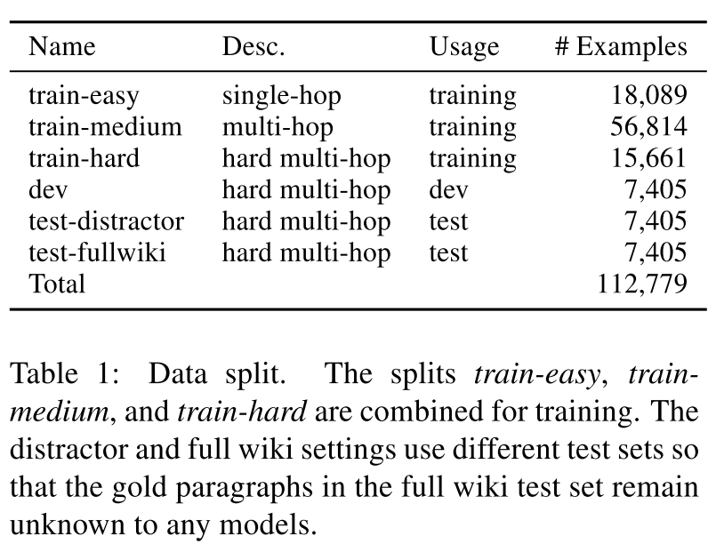
3. Processing and Benchmark Settings
Data :
One-step
Baseline
Hard

Slide 11
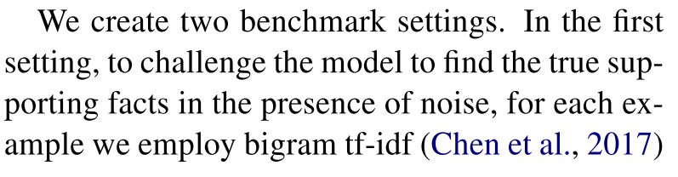
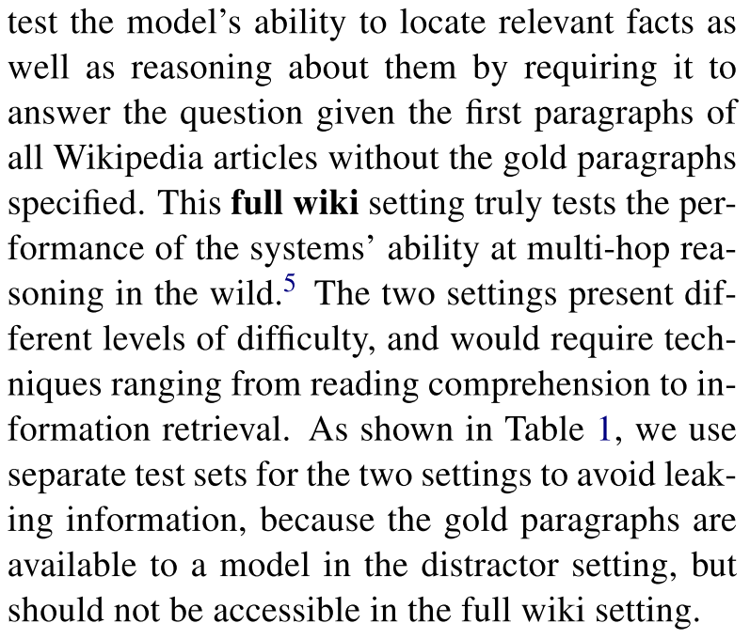
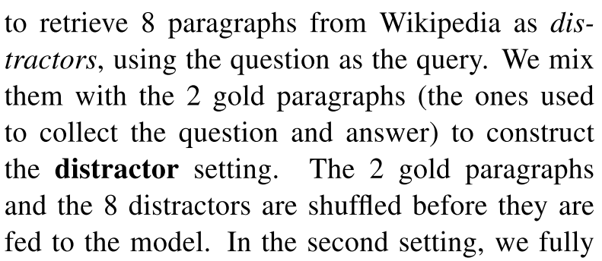
3. Processing and Benchmark Settings
Benchmark settings: distractor setting and full wiki

Slide 12
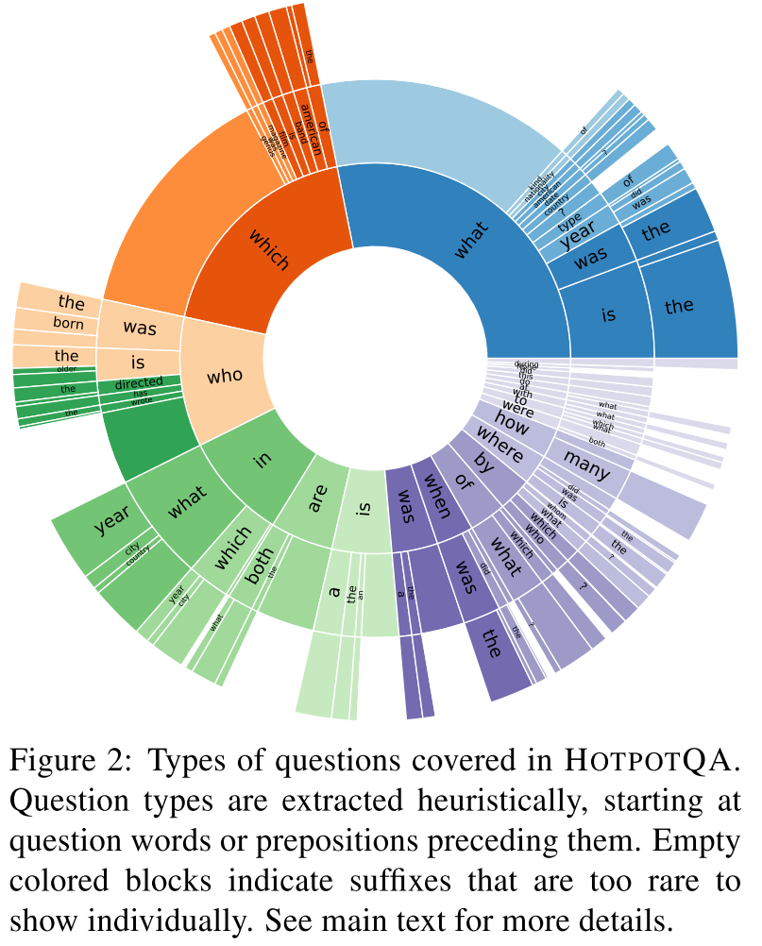
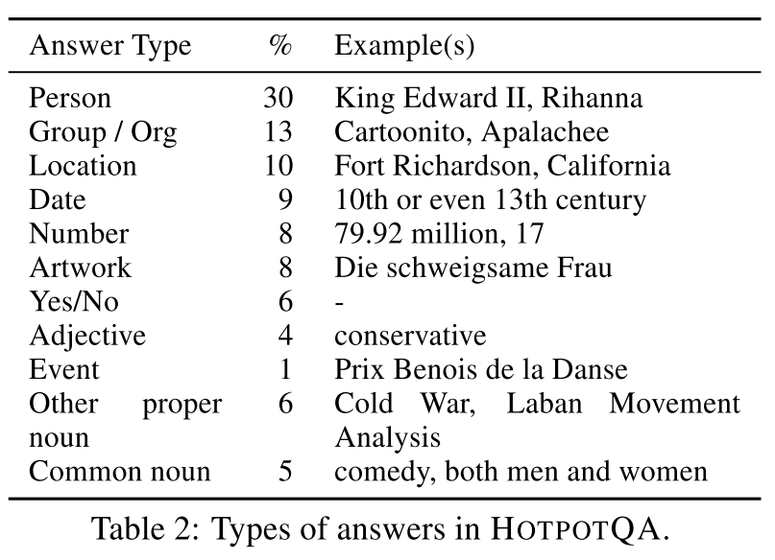
4. Dataset Analysis
In this section, the authors analyze the types of questions, types of answers, and types of multi-hop reasoning covered in the dataset.

Slide 13
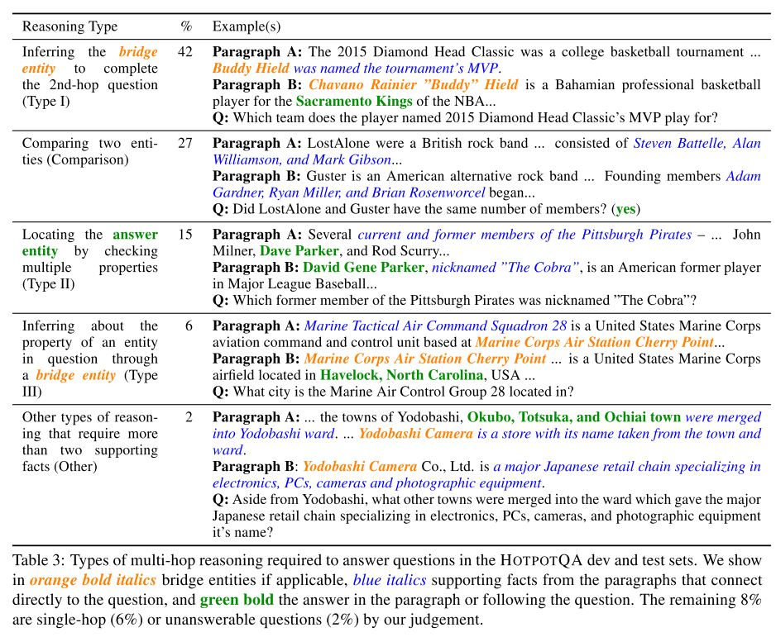
4. Dataset Analysis

Slide 14
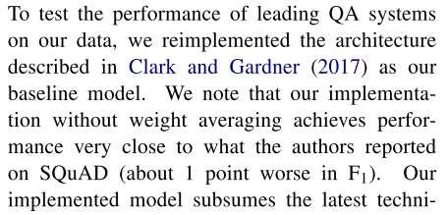
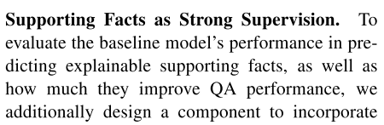
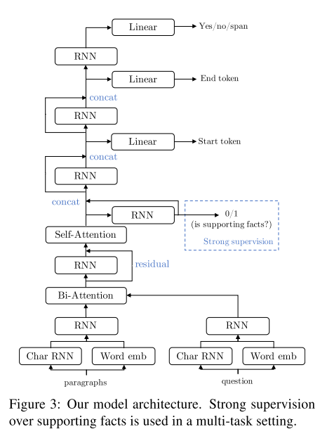
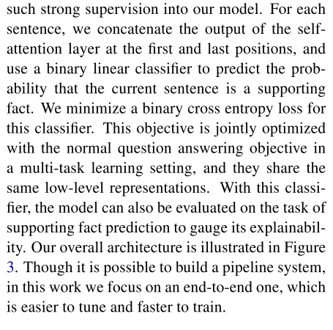
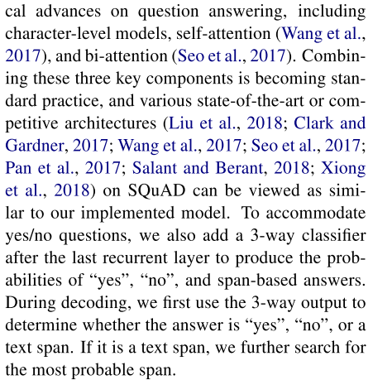
5. Experiments
Model Architecture and Training:

Slide 15
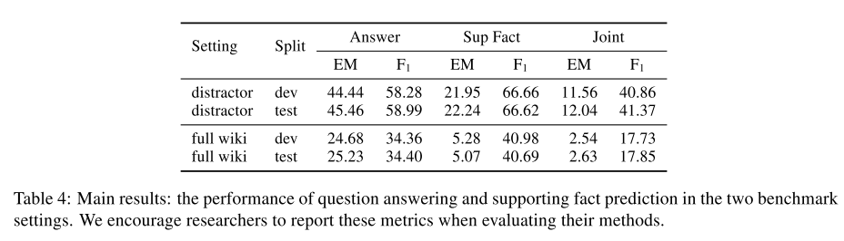
5. Experiments
Results:

Slide 16
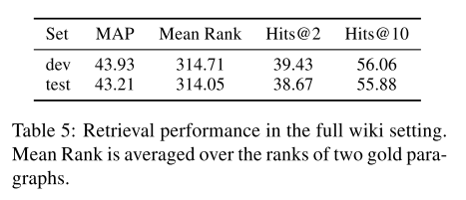
5. Experiments
Results:

Slide 17
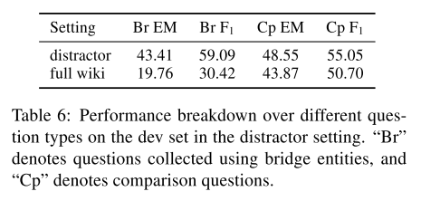
5. Experiments
Results:

Slide 18
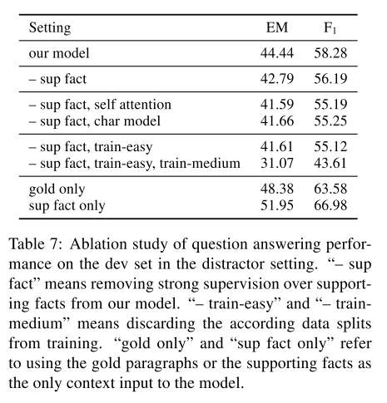
5. Experiments
Results:

Slide 19
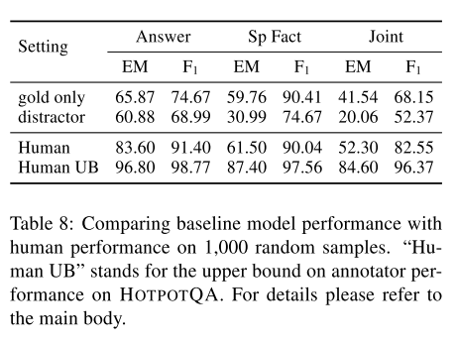
5. Experiments
Results:

Slide 20
6. Related work
Various recently-proposed large-scale QA datasets can be categorized in four categories:
Single-document datasets
Multi-document datasets
KB-based multi-hop datasets
Free-form answer-generation datasets

Slide 21
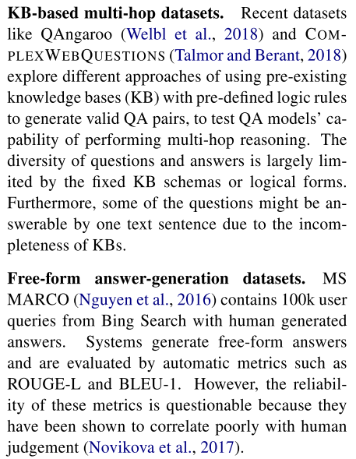
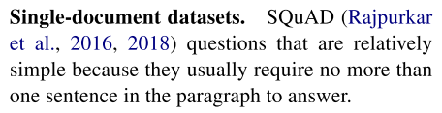
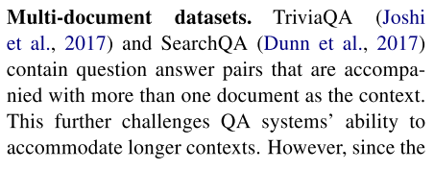
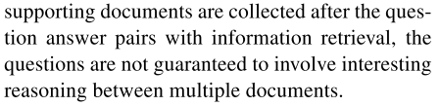
6. Related work
Categories:

Slide 22
7. Conclusion
The author present HOTPOTQA, a large-scale question answering dataset aimed at facilitating the development of QA systems capable of performing explainable, multi-hop reasoning over diverse natural language. We also offer a new type of factoid comparison questions to test systems’ ability to extract and compare various entity properties in text.

Slide 23


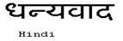




Hindi
Traditional Chinese
Thai
Thank You
Gracias
Russian
Spanish
Obrigado
English
Danke
Brazilian Portuguese
Arabic
Grazie
German
Italian
Merci
French
Simplified Chinese
Tamil
Korean
Japanese
Notes:
23

